Slide 1
Welded Extension Section

Slide 2
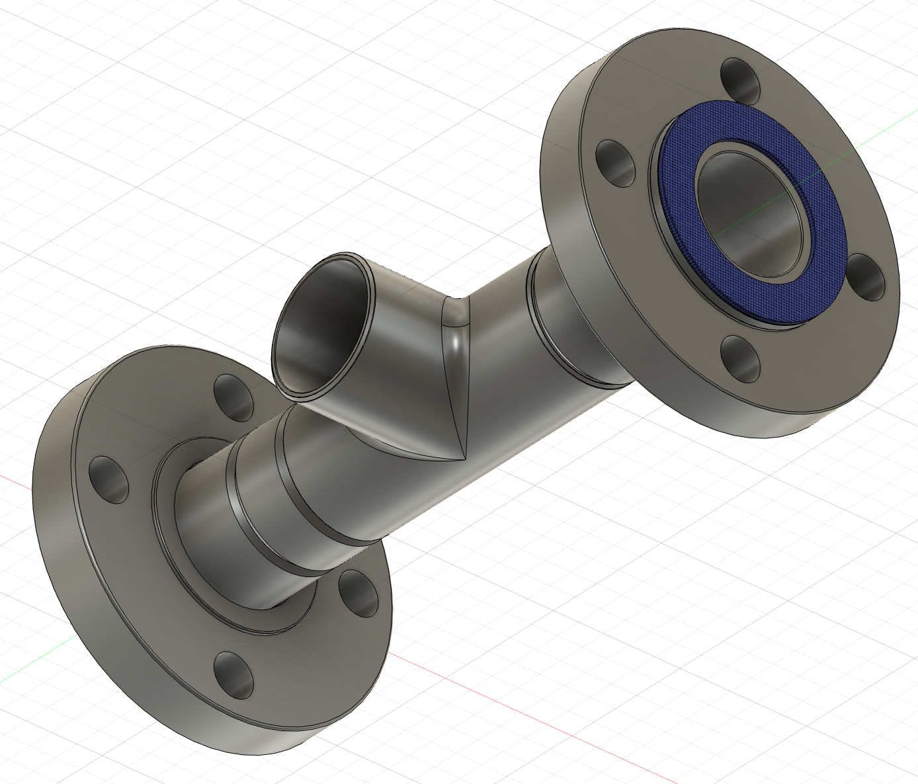
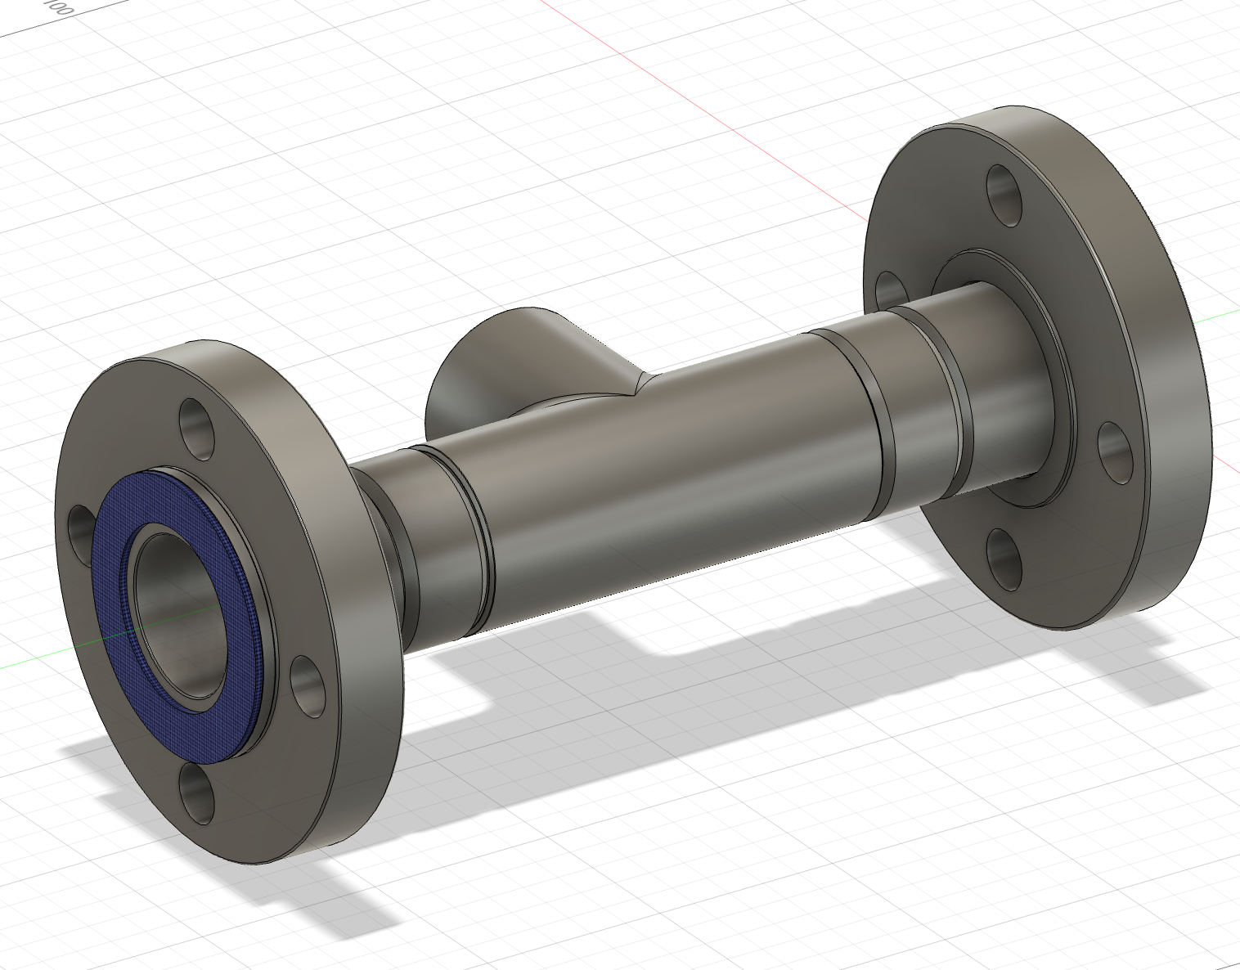
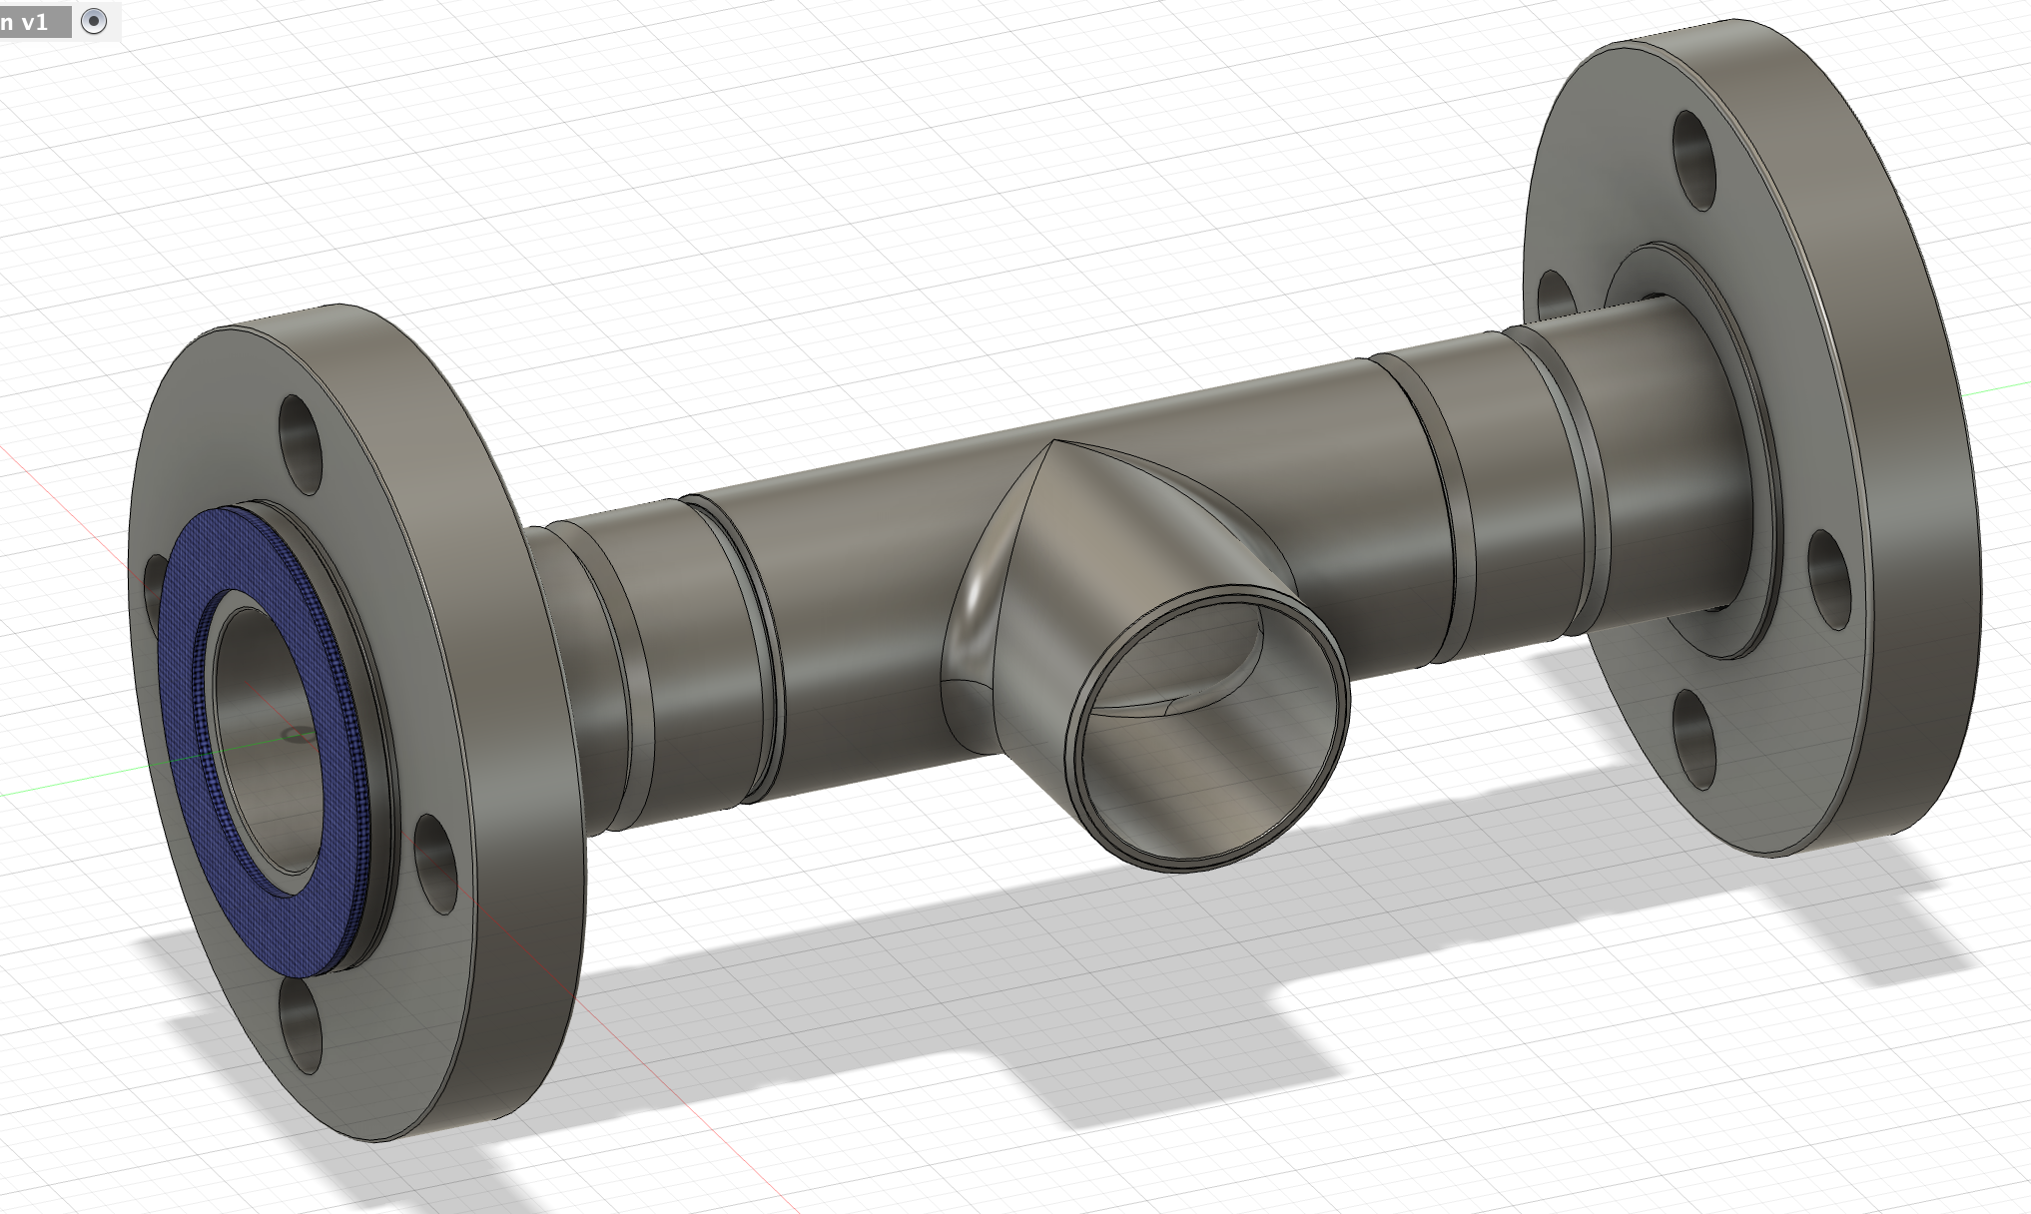
Complete Welded Extension
Cost
(Flanges) 2 x $63.10 = $126.2
(Pipes) 2 x $58.98 = $117.96
(Flng Pipes) 2 x $75.45 = $150.90 +
(T-Pipe)1 x $44.86 = $44.86
(Seal) 2 x $10.97 = $21.94
--------------------------------------------
Total cost ========== $461.86
Length = 267.4 mm

Slide 6
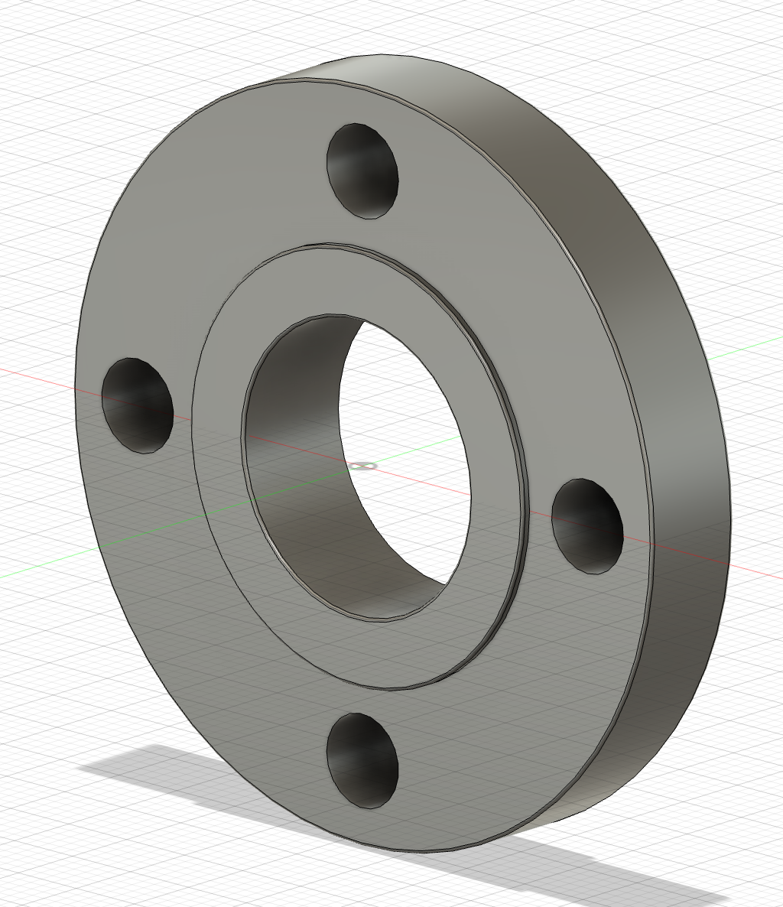
Welded Flange
Cost
$63.10 each
2 flanges used
Total = $126.2
Welded Flange Grainger Link

Slide 7
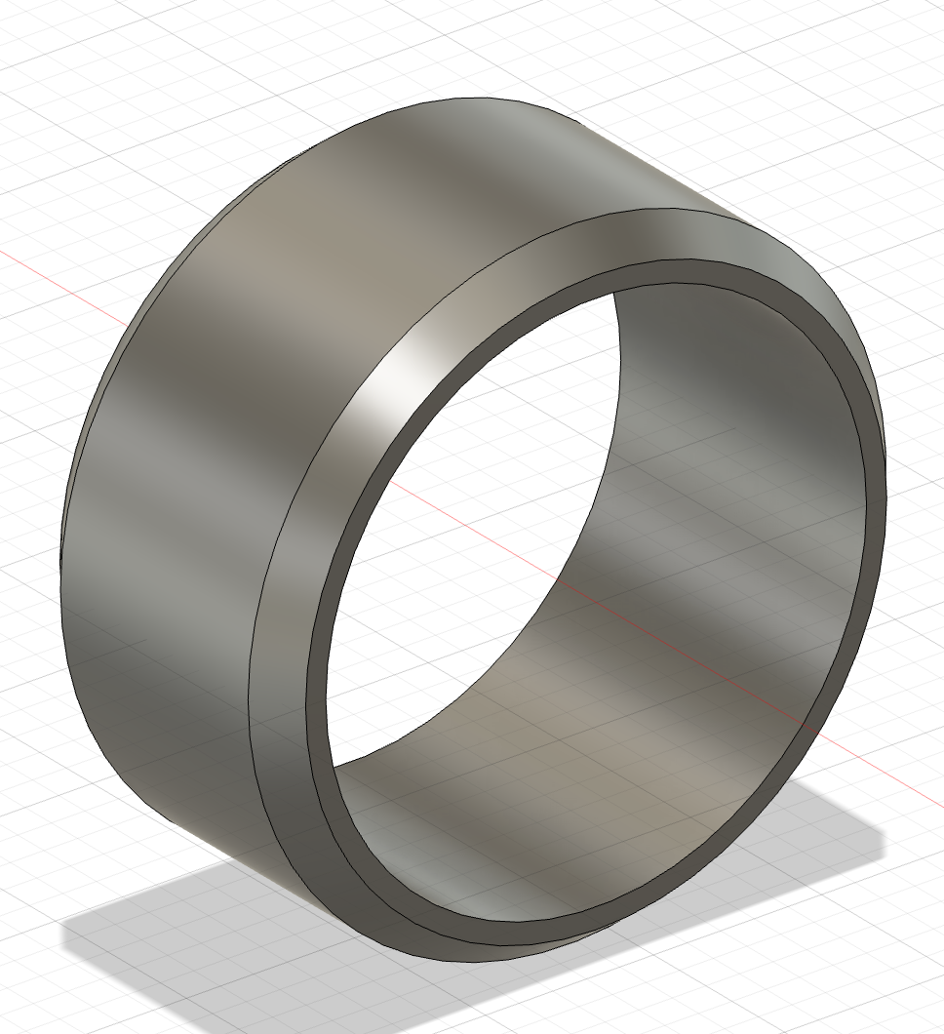
1 ½ Weld Extension Pipe
Cost
$58.98 each
2 pipes used
Total = $117.96
This pipe is a custom-cut 23.8 mm
piece a 1 ft long pipe
Welded pipe Grainger Link

Slide 8
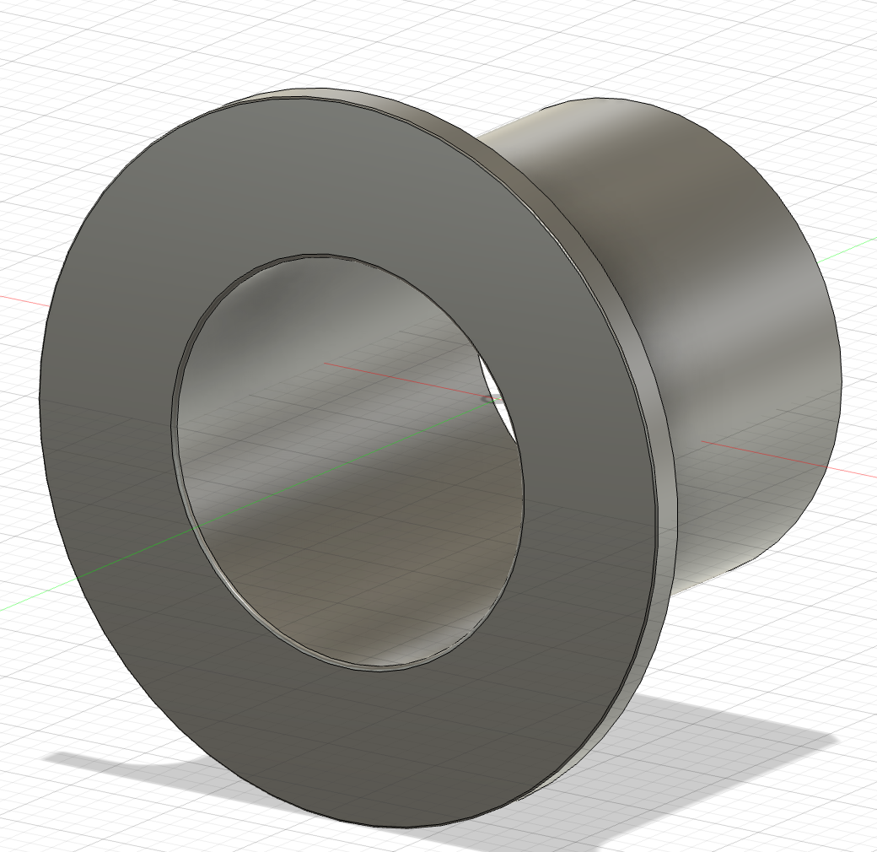
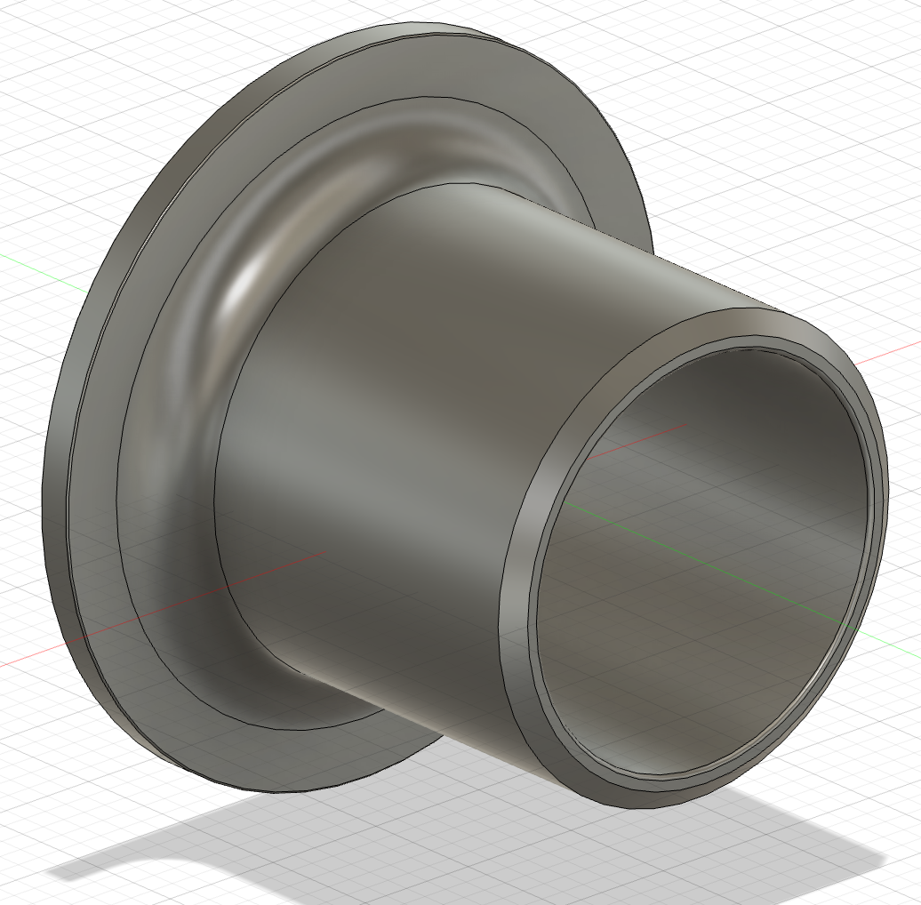
Flange Step End Pipe
Cost
$75.45 each
2 Flange Pipes used
Total = $150.90
Step End Pipe Graigner Link

Slide 9
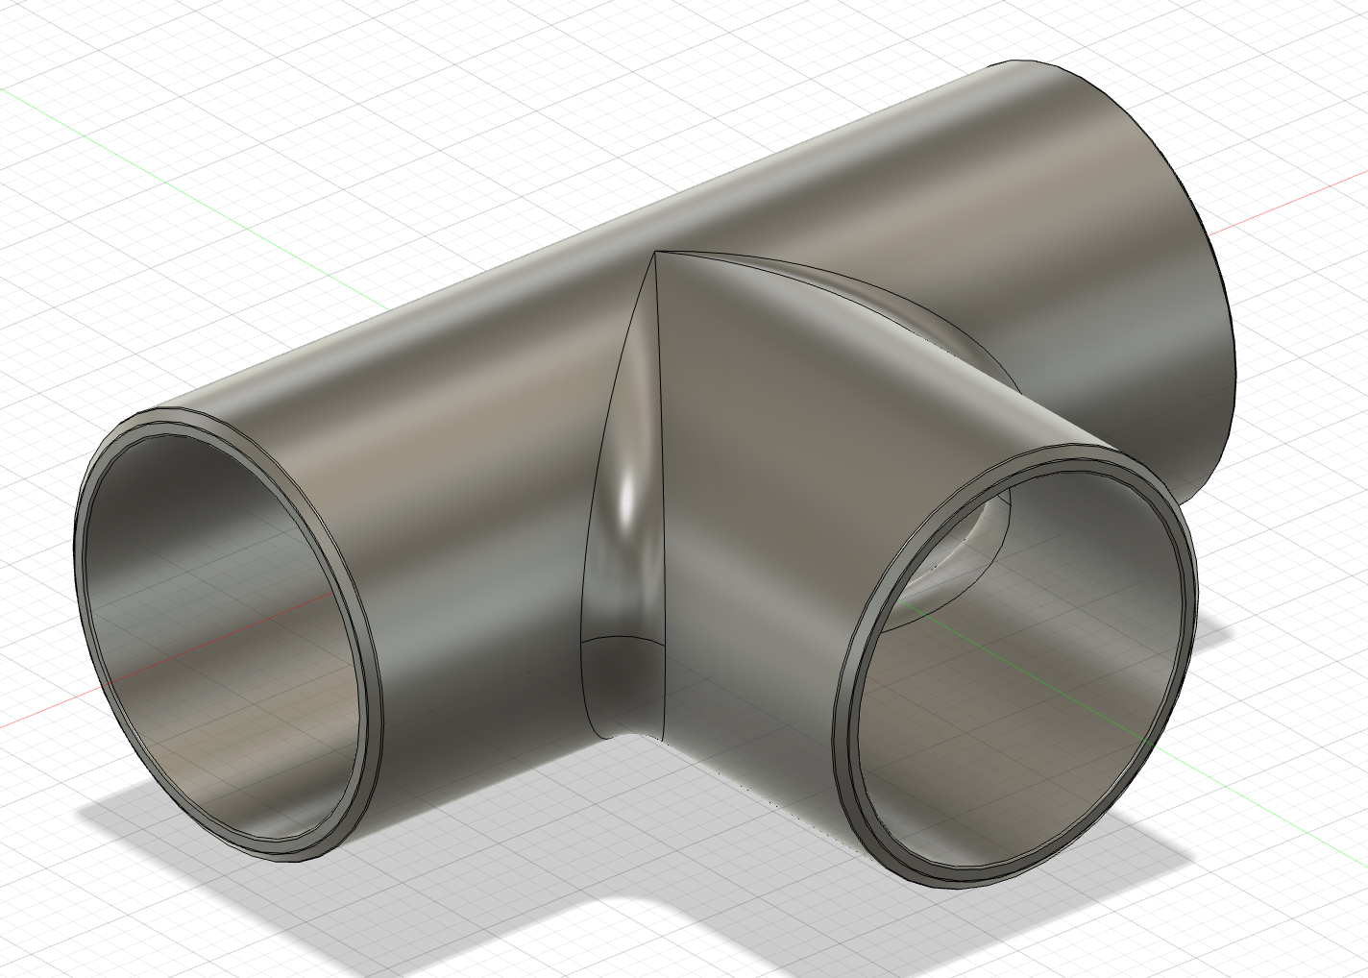
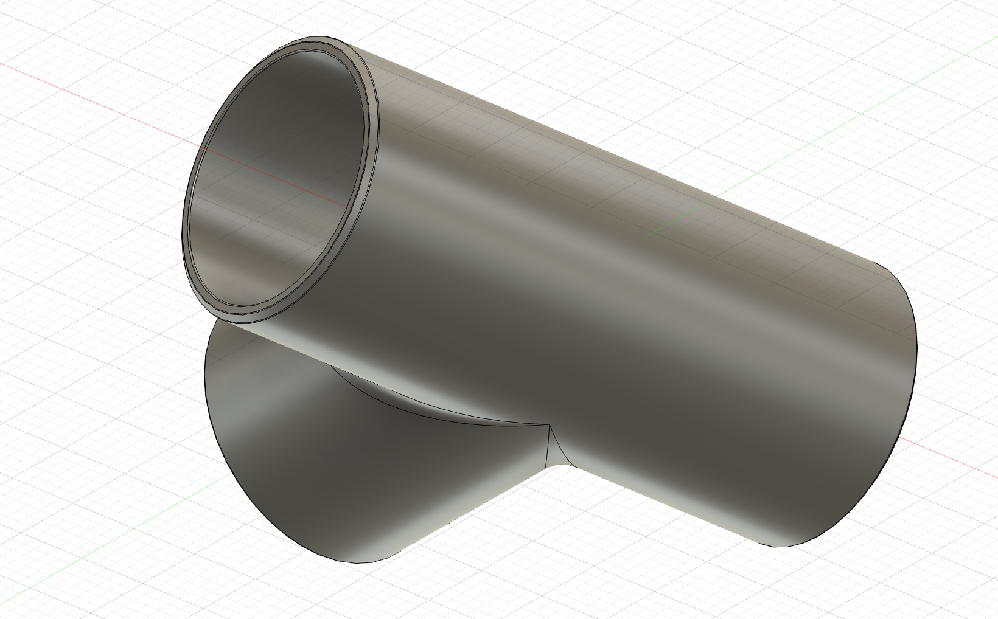
Welded T-Pipe
Cost
$44.86 each
1 T-Pipe used
Total = $44.86
Welded T-Pipe Grainger Link

Slide 10

Average Flange Blue Seal
Cost
$10.97 each
2 seals used
Total = $21.94
Flange Seal Grainger Link

